Slide 1

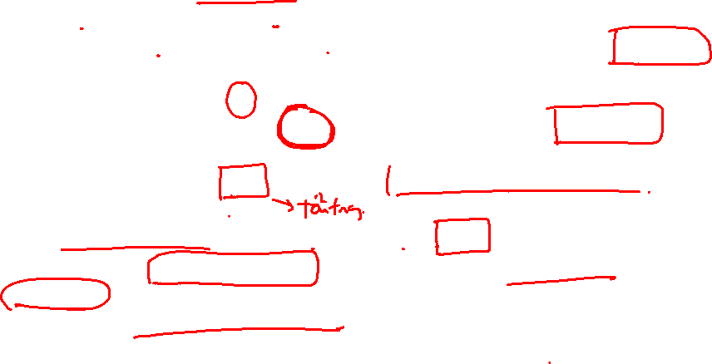
Capacitated Vehicle Routing
A fleet of K trucks 1, 2, …, K must be scheduled to visit N customers 1, 2, …, N for collecting items
Customer i located at point i and requests to be collected r(i) items, i = 1, 2, …, N
Truck k (k = 1,…, K)
Departs from point N+k and terminates at point N + K + k (N+k and N+K+k might refer to the central depot)
has capacity c(k) which is the maximum number of items it can carry at a time
Travel distance from point i to point j is d(i,j), i,j = 1,…,N + 2K
Compute the delivery solution such that the total travelling distance is minimal
Satisfy capacity constraints
Each customer is visited exactly once by exactly one truck

Slide 2

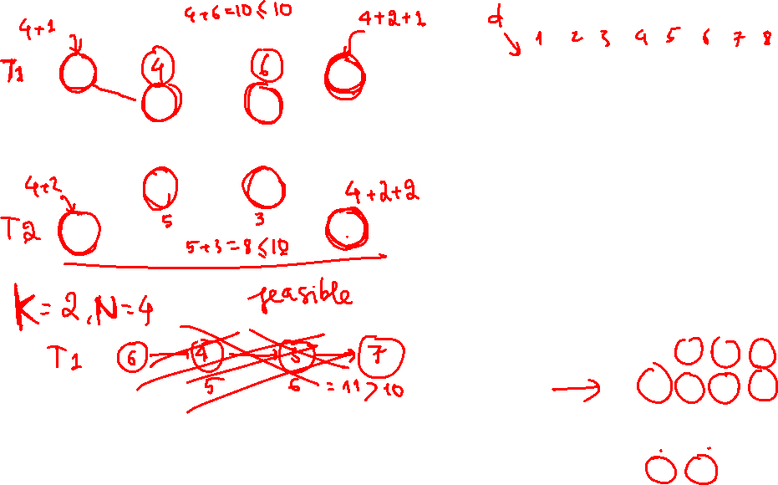
Capacitated Vehicle Routing Problem
5
7
1
2
3
4
5
6
7
8
0 | 2 | 3 | 4 | 3 | 3 | 3 | 3
4 | 0 | 2 | 6 | 1 | 1 | 1 | 1
2 | 4 | 0 | 2 | 1 | 1 | 1 | 1
5 | 7 | 7 | 0 | 4 | 4 | 4 | 4
3 | 1 | 5 | 7 | 0 | 0 | 0 | 0
3 | 1 | 5 | 7 | 0 | 0 | 0 | 0
3 | 1 | 5 | 7 | 0 | 0 | 0 | 0
3 | 1 | 5 | 7 | 0 | 0 | 0 | 0
1
3
4
2
6
8
1 2 3 4
r
4 | 3 | 6 | 5
1 2
c
10 | 10

Slide 3
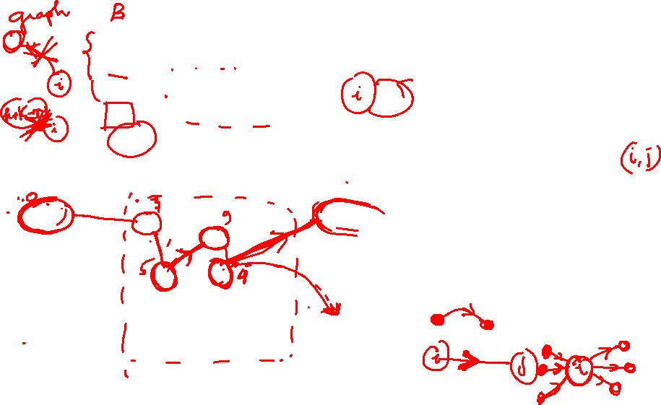
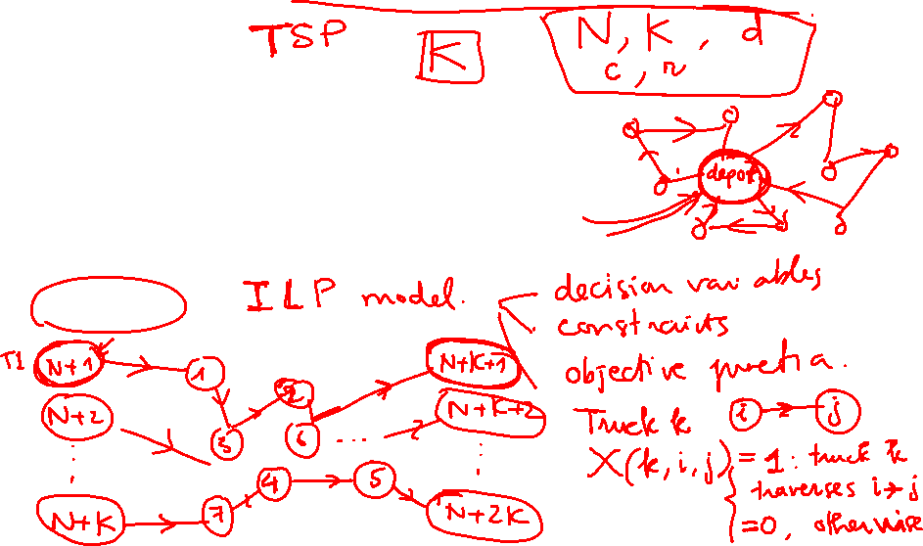
Capacitated Vehicle Routing Problem
Notations
B = {1,…, N+2K}
F₁ = {(i, k+N) | i ∈ B, k ∈ {1,…,K}}
F₂ = {(k+K+N, i) | i ∈ B, k ∈ {1,…,K}}
F₃ = {(i, i) | i ∈ B}
A = B² \ F₁\ F₂ \ F₃
A⁺(i) = { j | (i, j) ∈ A}, A⁻(i) = { j | (j, i) ∈ A}
Model ?

Slide 4
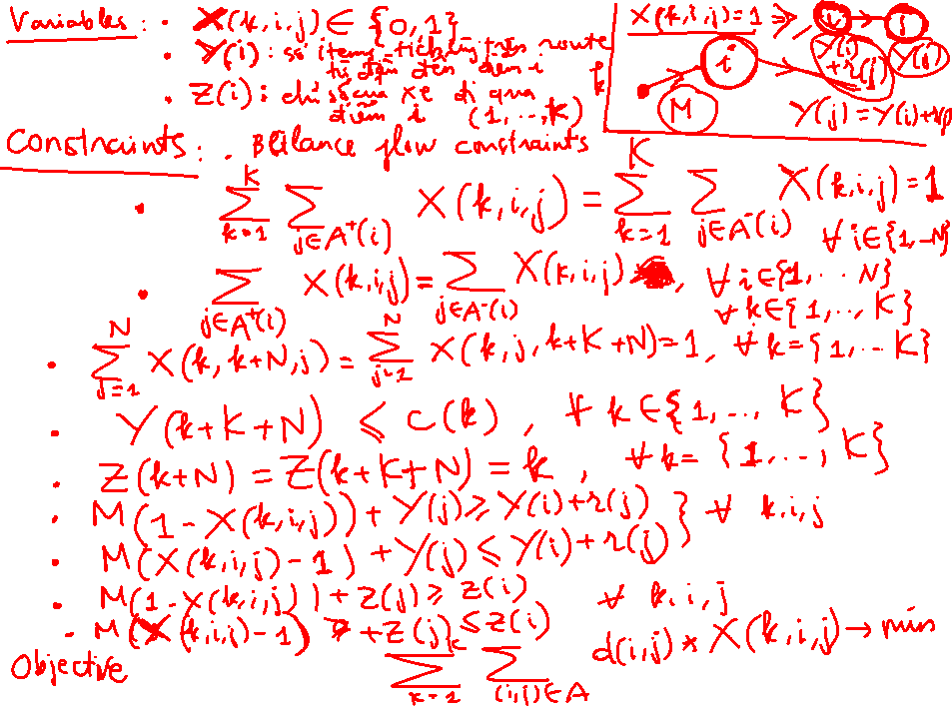
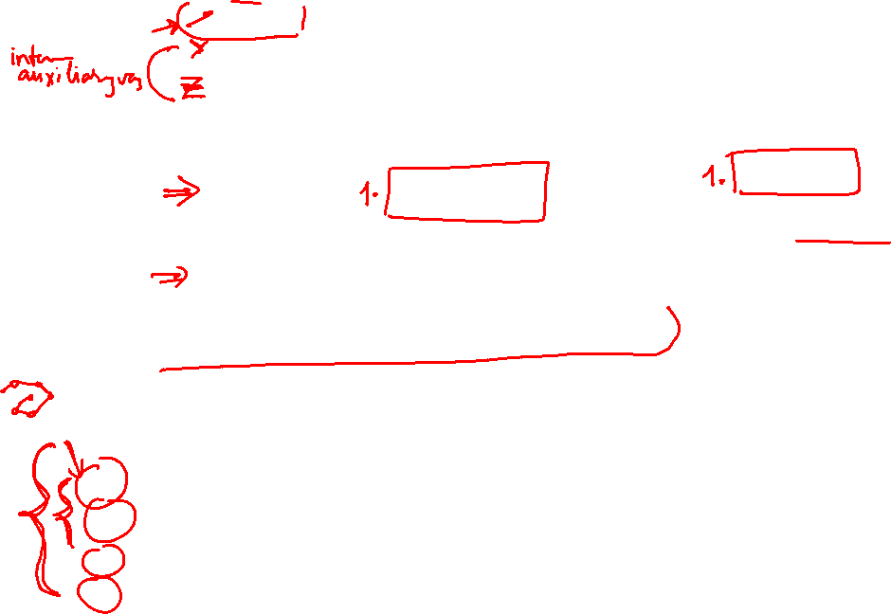
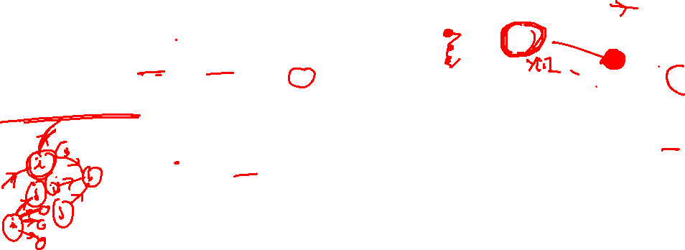

Slide 5
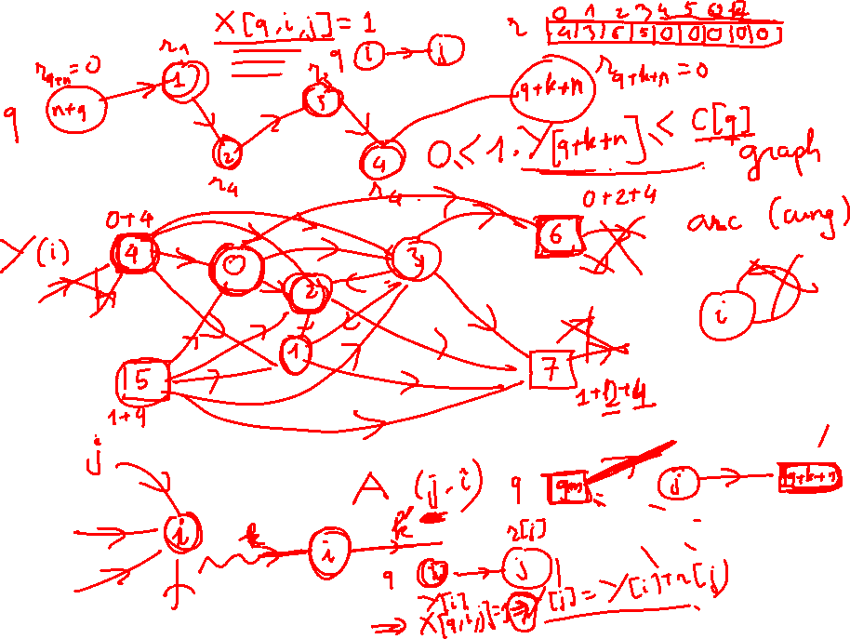
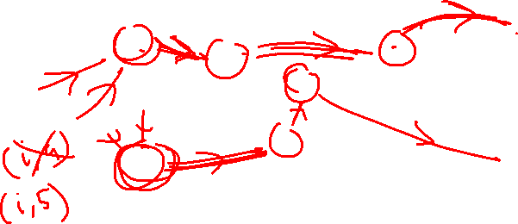

Slide 6
